Slide 1
Introduction of Math of MBD
Part 1: MBD Equations of Motion
Graham Sanborn
FunctionBay, Inc. R&D Group.
2022/04/06
Copyright © 2022 FunctionBay, Inc. All rights reserved.

Slide 2
Overview
Goal
Introduce the mathematics of Multibody Dynamics
3 Parts:
MBD Equations of Motion
Solving the Equation of Motion
Special Features
Contact
Flexible bodies

Slide 3
Presentation Parts
MBD requires 2 parts:
Equations of motion
f = ma
The solution to the equations of motion
time stepping
The third part extends MBD’s capabilities.
Flexible bodies and contact

Slide 4
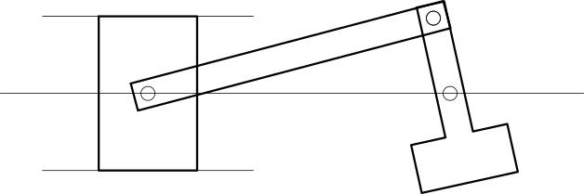
Part 1:
MBD equations of motion

Slide 5
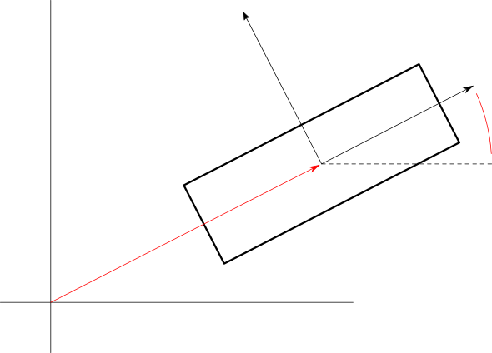
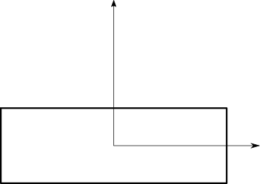
Body Dynamics
Dynamics of a rigid body
Every body has a position and an orientation.
Consider a body (Body i) in 2 dimensions
It has 3 coordinates:
x^{i} = [x^{i}, y^{i}]^{T} : Position of the center of mass
θ^{i}: Orientation
Body i in the global reference frame
y
Body i
θ^{i}
x^{i}
x

Slide 6
In this Seminar, 2D Only
In this seminar, we will only consider 2D.
3D rotation is complex.
There are many details, equations, considerations.
The fundamental MBD concepts are the same for 2D and 3D.
Rotation should be studied after the fundamental concepts are fully understood.

Slide 7
Body Dynamics
Body coordinates, velocities, and accelerations
y
θ^{i}
x^{i}
x^{i} : location of center of mass (CM) of Body i
x
Body coordinates
Body velocities
Body accelerations

Slide 8
What is MBD?
What is Multibody Dynamics (MBD)?
Motion of a system of connected bodies
What is “motion”?
Motion = position, velocity, and acceleration, over time
Mathematics of motion = the “equations of motion”
Really, the acceleration equations.
MBD starts from the acceleration equations of acceleration of a single rigid body.
translation
rotation

Slide 9
Rigid Body Dynamics
Single rigid body
The equations of motion are called the “Newton-Euler equations”.
Well-known acceleration equations
Newton
(translational acceleration)
Euler
(angular acceleration)

Slide 10
Rigid Body Dynamics
Consider a single rigid body in 2D
2 translational acceleration equations
1 rotational acceleration equation
y
translational
θ^{i}
x^{i}
rotational
x

Slide 11
Rigid Body Dynamics
2D Newton-Euler equations in matrix notation
Matrix - vector notation

Slide 12
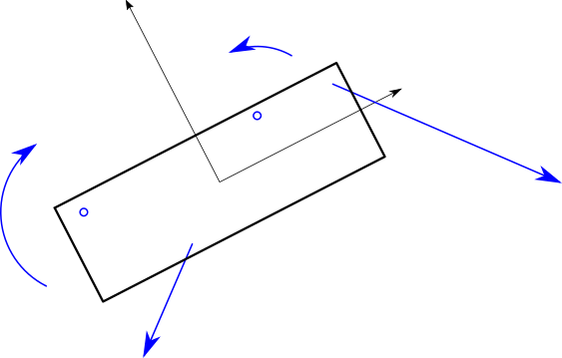
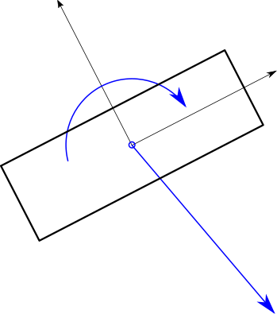
Net Force Vector
Forces and torques in the Newton-Euler equations
Vector f^{i} is the sum of all forces and torques acting on the body.
Many forces and torques acting on Body i
Net forces and torques acting on Body i
t₂^{i}
t₁^{i}
[ f_{x1}^{i},f_{y1}^{i} ]
t^{i}
[ f_{x2}^{i},f_{y2}^{i} ]
[ f_{x}^{i} , f_{y}^{i} ]

Slide 13
Necessity of Forces
If f^{i} is known, then the dynamics of body i is completely
known.
It is possible to predict q^{i}, q̇^{i}, and q̈^{i} for all time.
Note:
A differential equation solution method is required to get q^{i}, q̇^{i}, and q̈^{i} for all time.
Therefore, the goal is to find f^{i}.
The difficulty is formulating the forces.

Slide 14
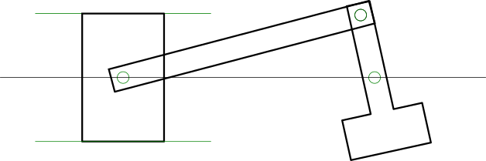
What is MBD?
What is Multibody Dynamics?
Dynamics of a system of bodies.
More than one body.
The bodies are connected.
Connected by rigid joints and elastic elements.
Engine System
Revolute Joint
Connecting Rod - Crankshaft
Translation Joint
(Piston-Cylinder)
Piston
Connecting Rod
Revolute Joint
(Crankshaft - Crankcase
Revolute Joint
(Piston-Connecting Rod)
Cylinder/Crankcase
Crankshaft

Slide 15
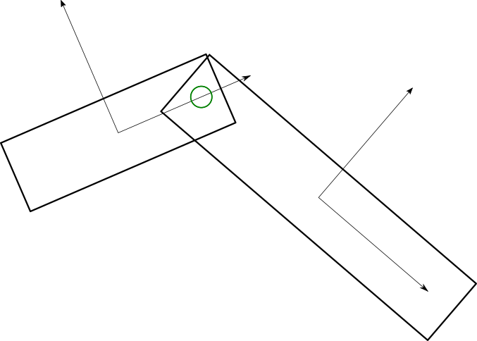
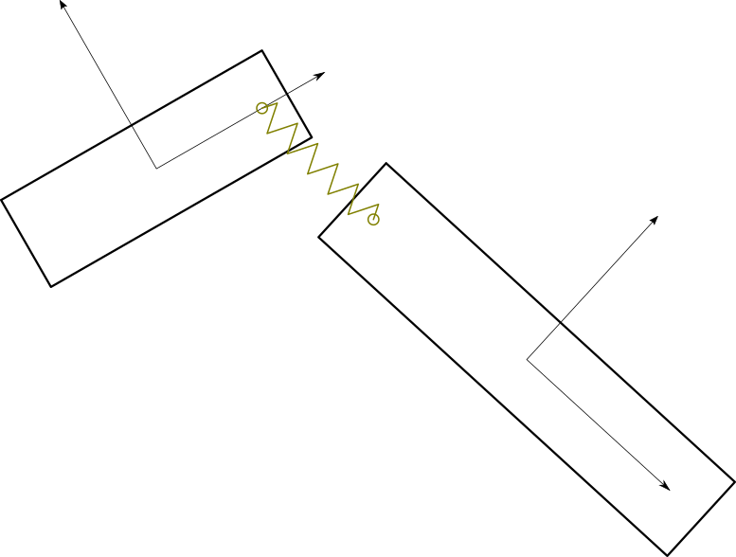
Body Connections
Rigid joints
Examples
Hinges (Revolute)
Pistons in cylinders
Spherical joints
Elastic elements
Examples
Springs
Rubber bushings

Slide 16
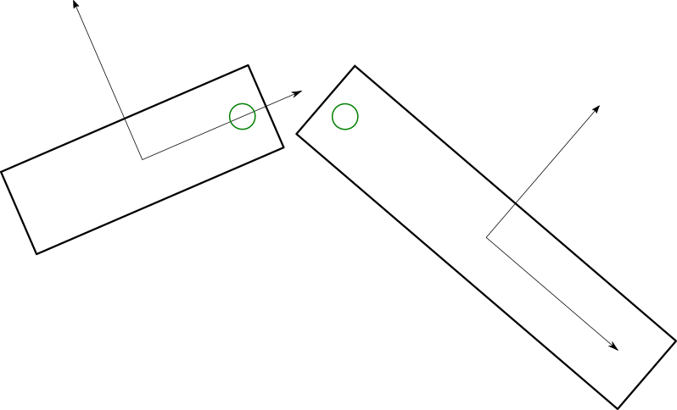
Body Connections
Good
Bad
Rigid joints
Algebraic restrictions on permissible positions
Elastic elements
Any positions are
permissible
Good

Slide 17
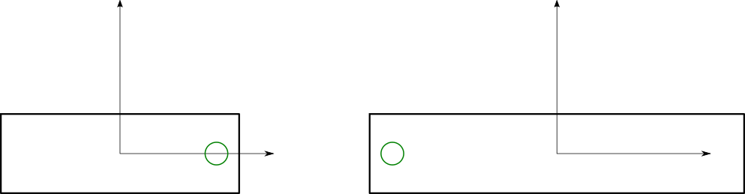
Rigid Joints
Also called constraints or kinematic constraints
An algebraic condition:
p_{a}^{i} = p_{b}^{j}
These points must always be in the same location
A simplification of reality.
p_{a}^{i} = p_{b}^{j}
Body i
Body j
Body i
Body j
p_{a}^{i}
p_{b}^{j}

Slide 18
Rigid Joints
Rigid joints / Constraints are very important.
Benefit:
High detail with low computation
Large time steps
Reasonable approximation of reality in most cases
Difficulties
Difficult to solve equations of motion when constraints exist
Complex formulation
Singular configurations
Possibility of over-constraint

Slide 19
MBD System of Equations
System equations of motion are written using system matrices and vectors.
Newton-Euler equations of motion for each body
System mass matrix
System acceleration and force vectors
System equations of motion

Slide 20
System Force Vector f
System force vector f contains all body force vectors f^{i}.
f is the net forces acting on every body.
Including connection forces.
Rigid joint constraint forces
Elastic forces
Also gravity and any other forces
Includes all connection forces (constraint, elastic)

Slide 21
Elastic vs Constraint Connection Formulations
Elastic force and constraint force formulation
Similar
But with some key differences
Elastic forces
Only depend on body positions
(and velocities)
Constraint forces
Constraint forces are coupled with the body accelerations.
Constraint forces and accelerations must be found simultaneously.

Slide 22
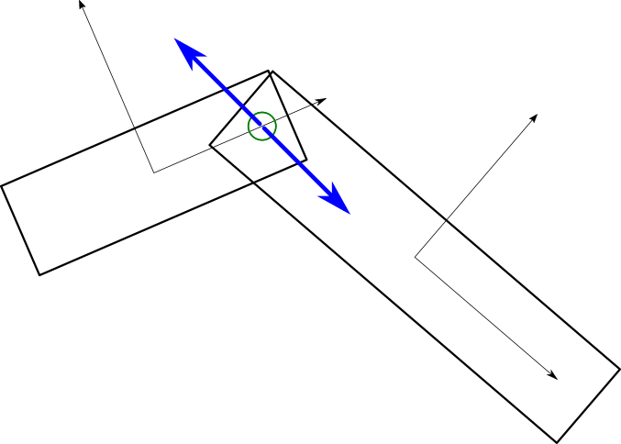
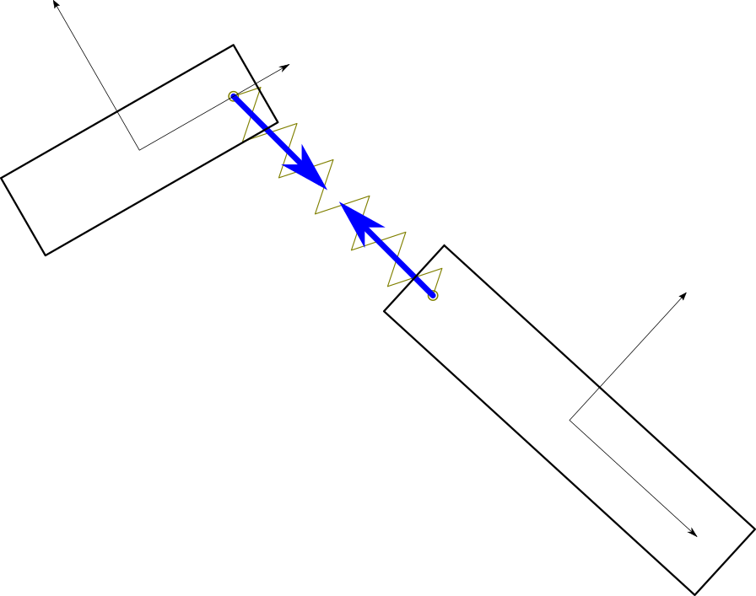
Connection Force General Concepts
Connection elements have an element force that acts on points on the bodies.
2 concepts are needed to formulate connection forces
Expressing the global position of a point on a body
Transformation of an element force into a body force

Slide 23
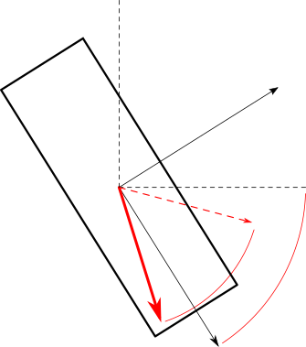
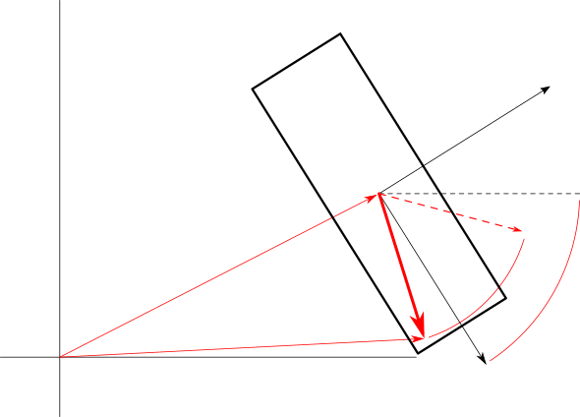
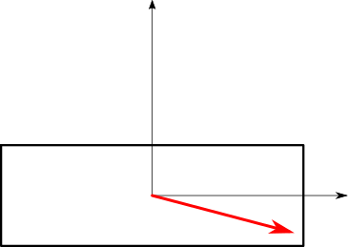
Global Position of a Point on a Body
Connection element forces are applied at a point on a body
The point is defined in the body reference frame.
The point moves with the body.

Slide 24
Global Position of a Point on a Body
sʹ_{a}^{i} is the point in the body’s reference frame.
If the point on Body i is fixed, then sʹ_{a}^{i} is a constant.

Slide 25
Global Position of a Point on a Body
sʹ_{a}^{i} rotates with the body.
s_{a}^{i} is the point after rotation.
A^{i} is a rotation matrix.

Slide 26
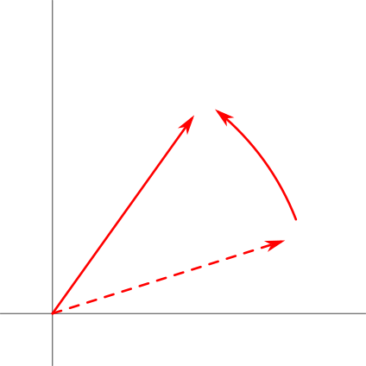
Global Position of a Point on a Body
Rotation matrix A^{i}
v = A^{i}vʹ rotates the vector vʹ counter-clockwise by θ^{i} radians around the origin.

Slide 27
Global Position of a Point on a Body
p_{a}^{i} is the global position of sʹ_{a}^{i} after it is rotated by A^{i} and translated by Body i’s center of mass x^{i}.

Slide 28
Derivatives, Vectors, and Matrices
In this document, derivatives of scalars and vectors by vectors are used frequently.
Derivatives of scalar values:
The partial derivative ∂s/∂v, where s is a scalar and v is a vector, is the row vector
where

Slide 29
Derivatives, Vectors, and Matrices
In this document, derivatives of scalars and vectors by vectors are used frequently.
Derivatives of scalar values:
The 2nd partial derivative ∂s/∂v∂w of scalar s by vectors v and w is a matrix
where

Slide 30
Derivatives, Vectors, and Matrices
In this document, derivatives of scalars and vectors by vectors are used frequently.
Derivatives of vectors:
The partial derivative ∂v/∂w, where v and w are vectors, is the matrix
where

Slide 31
Derivatives of Points on Bodies
The derivative of p_{a}^{i} with respect to body coordinates q^{i} is required in many parts of the MBD formulation.
Remember:
means: if x^{i} changes, how much does change?

Slide 32
Derivatives of Points on Bodies
Derivatives of a point on a body w.r.t. the body’s center of mass location
If x^{i} changes, how much does change the same amount.
If y^{i} changes, how much does change the same amount.

Slide 33
Derivatives of Points on Bodies
Derivatives of a point on a body w.r.t. the body’s rotation angle

Slide 34
Derivatives of Points on Bodies
The final form of the derivative of p_{a}^{i} with respect to body coordinates q^{i}:
Remember:

Slide 35
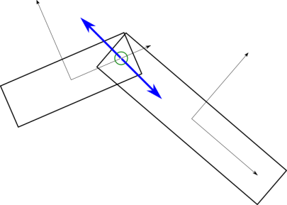
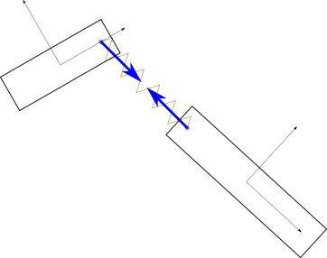
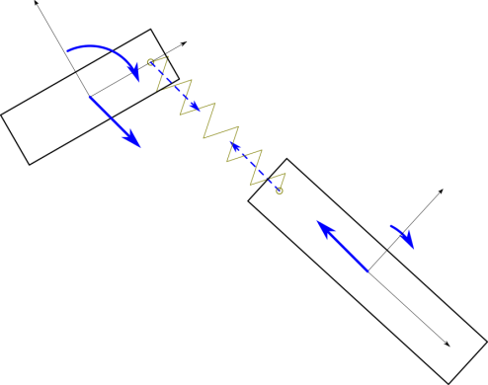
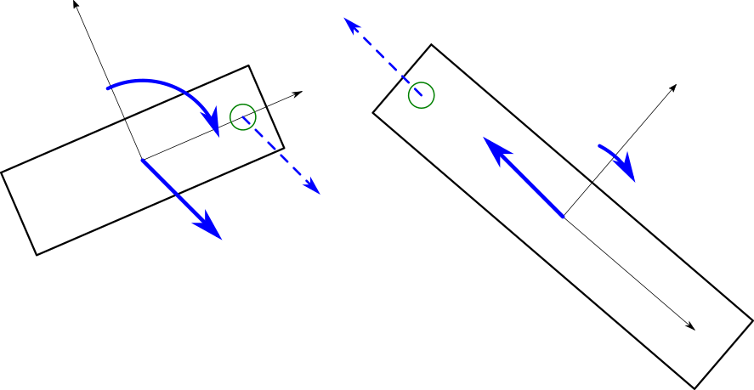
Transformation of Element Forces to Body Forces
Every connection has a connection force λ or λ^{e}.
The connection force must be transformed into body forces:
Constraint: f^{ci} and f^{cj}
Elastic: f^{ei} and f^{ej}.
Constraint
Elastic
Element forces
Body forces

Slide 36
Transformation of Element Forces to Body Forces
Transformation of an connection element force λ to a body force
The body force vector for Body i is
Force components f_{x}^{i} and f_{y}^{i} act on the center of mass.
Torque t^{i} acts on the body.

Slide 37
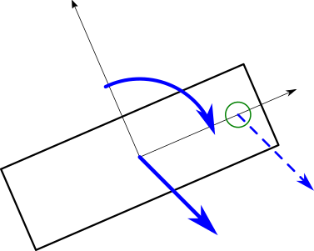
Transformation of Element Forces to Body Forces
If the connection element force is a point force vector λ acting on point sʹ_{a}^{i} on the body:
Element force
Body force

Slide 38
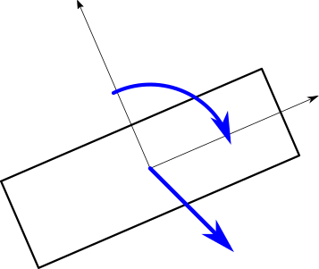
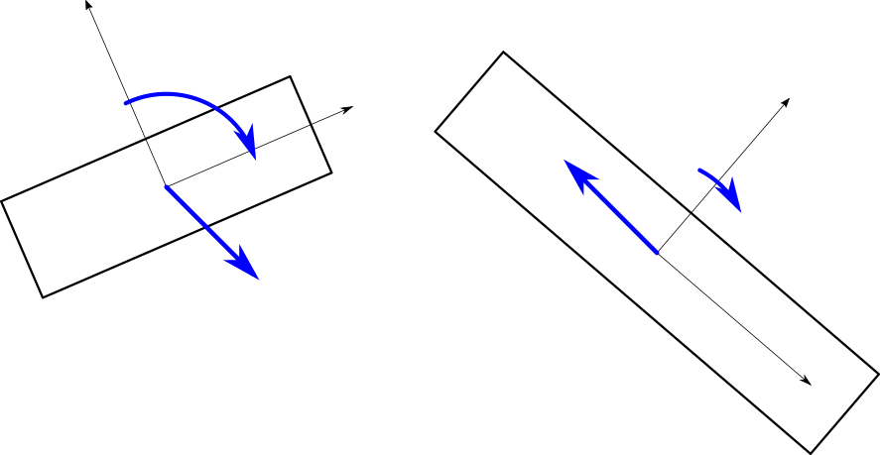
Reminder
If we can find f, then we can solve Mq̈ = f.
And then we know everything.
The goal:
Formulate the connection forces f^{c} and f^{e}.
Single rigid body
Multiple rigid bodies

Slide 39
System Force Vector Summation
The system force vector f is the sum of 3 parts:
Elastic connection forces f^{e}
Constraint connection forces f^{c}
Other forces fº
like gravity and externally applied forces
f^{c} is going to be converted into f^{c} = −φ_{,q}^{T}λ later.

Slide 40
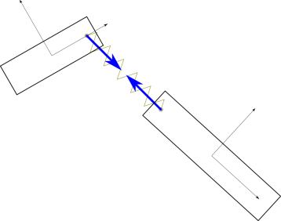
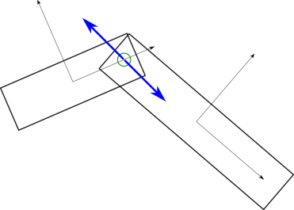
Connection Elements
The formulations for elastic and constraint connection element forces are similar.
The formulations will be shown using 2 examples
Elastic type:
Elastic bushing
Constraint type:
Revolute joint
Elastic bushing
Revolute constraint

Slide 41
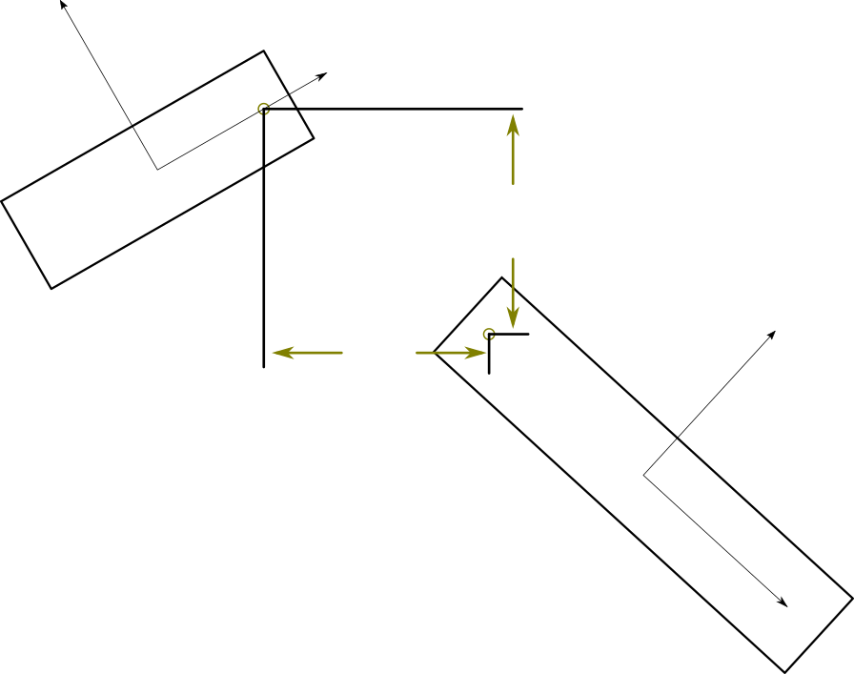
Elastic Connection Elements
Elastic elements connect 2 (or more) bodies.
Defined by a gap (or displacement) function φ.
φ can be a scalar or a vector.
The bushing element’s gap function φ is a vector.
φ₂
φ₁

Slide 42
Elastic Connection Elements
Elastic elements generate a restoring force λ^{e} when φ ≠ 0.
The force pushes in a direction that reduces φ.
The simplest and most common force is linear:
Body i: λ^{ei} = λ^{e} = − kφ
Body j: λ^{ej} = −λ^{e} = kφ
Which is λ^{e} and which is −λ^{e} depends on the formulation of φ.
The force applied to one body is λ^{e} and the other body is −λ^{e}.

Slide 43
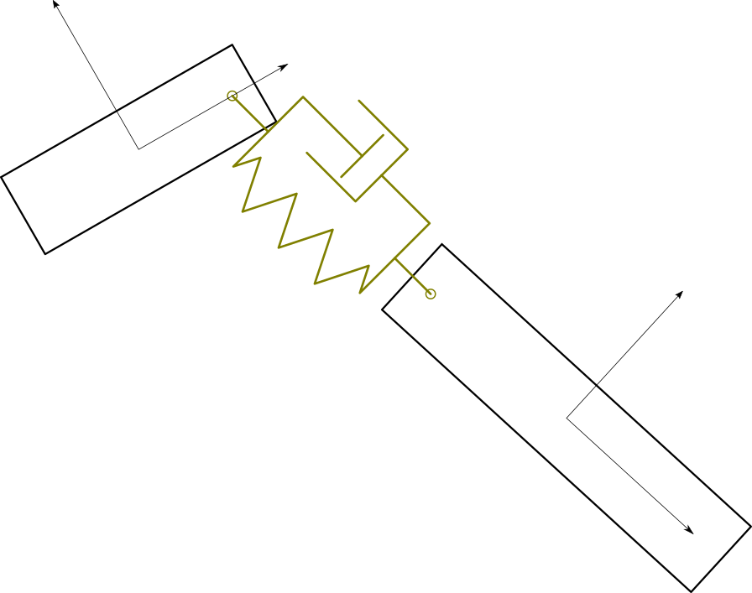
Elastic Connection Elements
Note that usually, elastic elements also generate damping forces.
Damping forces are a function of the velocity of the connected points.
We will ignore the damping forces now.
They are easy to formulate.
Damping part
Elastic part

Slide 44
Elastic Connection Elements
Elastic element forces λ^{e} are a function of body positions only.
Elastic element forces are independent of the acceleration.
So they are computed before acceleration and then summed with the system elastic force vector f^{e}.

Slide 45
Elastic Connection Elements
There can be many different kinds of elastic elements.
Examples
Point-to-point spring
Non-zero rest length
1 force component
Bushing spring
Zero rest length
2 force components
Rotational spring
Point-on-line spring

Slide 46
Elastic Connection Element Force Transformation
As previously mentioned, the elastic element force λ^{e} must be converted into body forces f^{ei} and f^{ej}.
This is the manual method of computing f^{ei}.
There is an automated method that is simpler for a program to execute.
Element force
Body force

Slide 47
Elastic Connection Element Force Transformation
The elastic element force λ^{e} transformation can be transformed automatically using φ_{,q}^{T}.
This will be shown using the elastic bushing element.

Slide 48
Elastic Element Example: Bushing
Example: a bushing element
Connects 2 points on 2 bodies
Point p_{a}^{i} on Body i and Point p_{b}^{j} on Body j.
Point p_{a}^{i}
Body i
Bushing element
Point p_{b}^{j}
Body j

Slide 49
Bushing Gap Function
Bushing element gap function
The gap function φ is a vector.
p_{a}^{i}
φ₂
φ₁
p_{b}^{j}

Slide 50
Bushing Element Force
Bushing element force
Simple force: −k times gap
The element force is also a vector.

Slide 51
Bushing Element Body Forces
Transformation of elastic element force to body force
Direct method

Slide 52
Bushing Body Forces from Derivative of φ
Compare with the derivative φ_{,q}^{T}:

Slide 53
Bushing Body Forces from Derivative of φ
Compare with the derivative of φ_{,q}^{T}:
The results are the same directly computing the body force vector or using φ_{,q}^{T}λ^{e}
Using φ_{,q}^{T}
Using direct computation of f^{ei} and f^{ej}

Slide 54
Elastic Body Force From Derivative of φ
The body forces computed directly and computing the using φ_{,q}^{T}λ^{e} are the same.
Why?

Slide 55
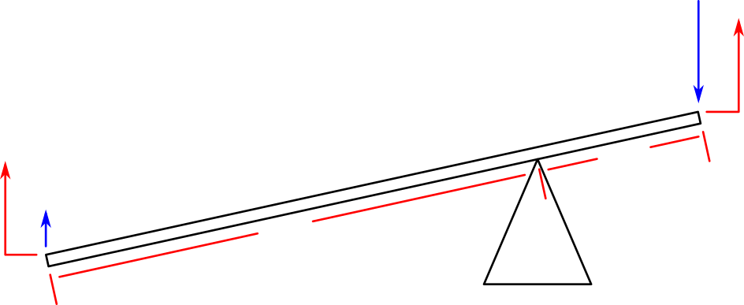
Elastic Body Force From Derivative of φ
Answer:
Same as leverage or mechanical advantage
Caused by conservation of energy
φ_{,q}^{T} is the mechanical advantage.
φ_{,xi}, φ_{,yi}, and φ_{,θi} are the change in φ caused by changes in x^{i}, y^{i}, and θ^{i}.
So f_{x}^{i} = φ_{,xi}^{T}λ^{e}, f_{y}^{i} = φ_{,yi}^{T}λ^{e}, and f_{θ}^{i} = φ_{, θi}^{T}λ^{e}.
f_{b}
y_{b}
y_{a}
l
so
f_{a}
3l

Slide 56
Elastic Body Forces in System Acceleration
When computing system accelerations q̈, the elastic forces can be computed first, before evaluating q̈.
Because the elastic forces only depend on the position coordinates q, they can be evaluated before q̈.

Slide 57
Elastic Force Complete
The bushing force is now complete.
The method of computing an elastic force has been completely described.
It is now possible to calculate
f = f^{e} + fº
Mq̈ = f
If there are no constraints, then q̈ can be computed by factorizing M and back-substituting f.

Slide 58
Rigid Joint Constraint Forces
Constraints have some similarities to elastic forces:
They use an identical gap function φ.
The constraint element force λ is transformed into body forces f by multiplying with the derivative of the gap function φ_{,q}^{T}.

Slide 59
Rigid Joint Constraint Forces
Constraint forces
But there are differences with elastic forces:
A gap is not permitted. This is enforced algebraically:
φ = 0
There is no stiffness.
These cause a few differences in the formulation.
Good
Bad

Slide 60
Rigid Joint Constraint Forces
gap = 0 is called the constraint equation
An algebraic equation.
Strictly enforces the joint condition

Slide 61
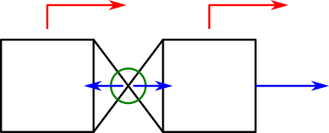
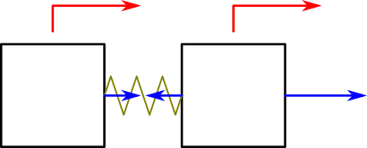
Constraint Force Differences from Elastic Forces
Consider these 2 models
2 stationary bodies, an external force applied to Body 1.
Model 1: Bodies connected with a constraint.
Model 2: Bodies connected with a spring, current at rest (φ = 0).
Find the values marked “?”.
Model 1: Constraint
Model 2: Spring
m²=1kg
m¹=1kg
f ¹ = 1N
m²=1kg
m¹=1kg
f ¹ = 1N
φ = 0
λ = ?
λ = ?
Body 2
Body 1
Body 2
Body 1

Slide 62
Constraint Force Differences from Elastic Forces
Consider these 2 models
In Model 1:
In Model 2:
Model 1: Constraint
Model 2: Spring
m²=1kg
m¹=1kg
f ¹ = 1N
m²=1kg
m¹=1kg
f ¹ = 1N
φ = 0
λ = 0N
λ = 0.5N
Body 2
Body 1
Body 2
Body 1

Slide 63
Constraint Force Differences from Elastic Forces
Consider these 2 models
In Model 1, the acceleration of the bodies and the constraint force are coupled.
They are not coupled in Model 2.
Model 1: Constraint
Model 2: Spring
m²=1kg
m¹=1kg
f ¹ = 1N
m²=1kg
m¹=1kg
f ¹ = 1N
φ = 0
λ = 0N
λ = 0.5N
Body 2
Body 1
Body 2
Body 1

Slide 64
Constraint Forces in Acceleration
The acceleration equation for constraints
The constraint forces and accelerations are dependent.
They are found simultaneously.
Constrained acceleration equation

Slide 65
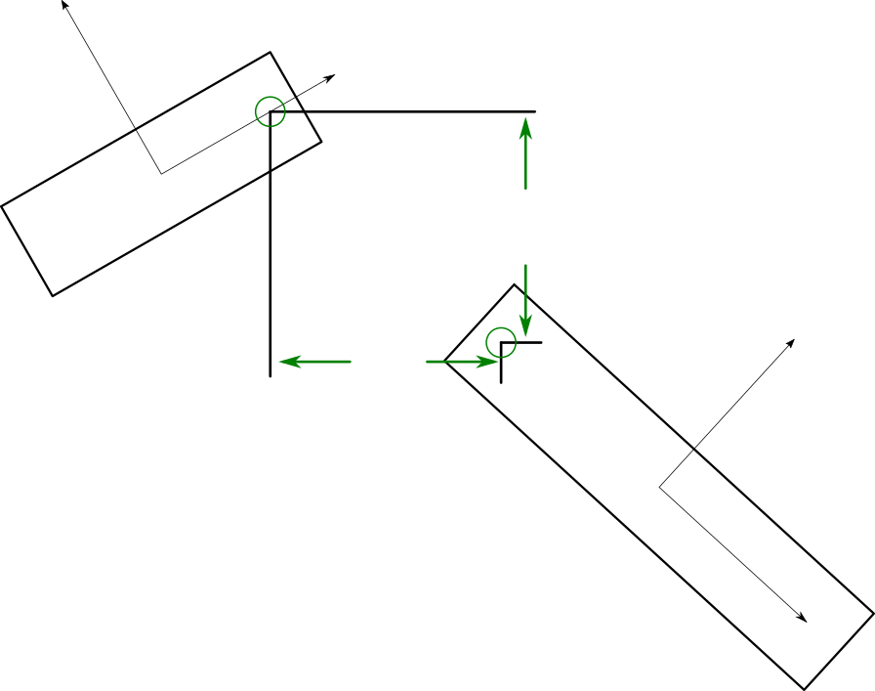
Constraint Example: Revolute Joint
Constraint version of elastic bushing element
Same gap function as a bushing
But gap must be zero.
Constraint gap function
Gap must be 0
φ₂
φ₁

Slide 66
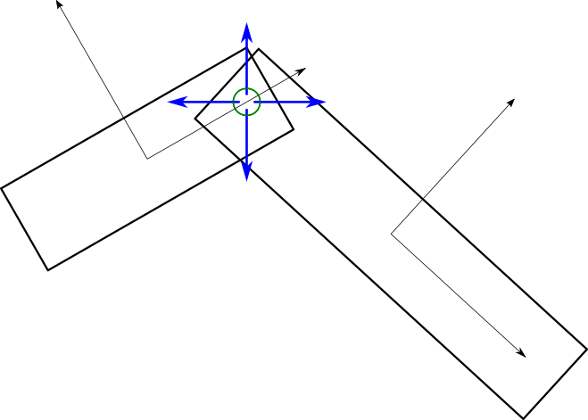
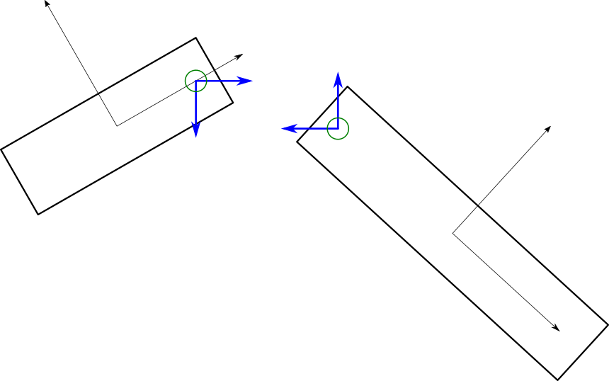
Constraint: Revolute Joint
Revolute joint element force vector is λ.
Like the elastic bushing, revolute joint λ is a vector.
2 components, which matches the gap function.
Constraint forces
Constraint forces on each body
λ₂
λ₁
−λ₁
λ₂
−λ₁
−λ₂
λ₁
−λ₂

Slide 67
Constraint: Revolute Joint Body Forces
The revolute joint uses exactly the same formulation as the elastic bushing element for transforming element forces into body forces.

Slide 68
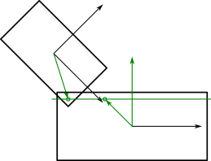
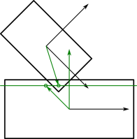
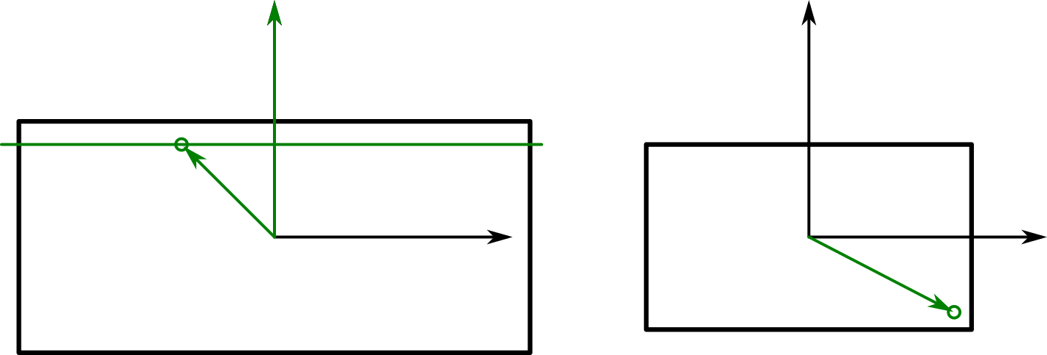
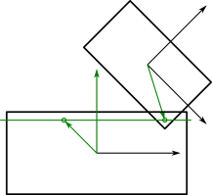
Another Constraint Example
A translational joint
Bodies i and j slide on a line relative to each other without rotation
Like a piston in a cylinder in 2D
2 constraint equations
Equation 1: The angular difference between the bodies must be user-defined constant Δ.
Equation 2: A point on Body j must always be on a specified line on Body i.
p_{b}^{j} must always be on the line normal to n^{i} that passes through p_{a}^{i}.
nʹ^{i}
where
sʹ_{a}^{i}
sʹ_{b}^{j}
Body i
Body j
Notes:
Δ

Slide 69
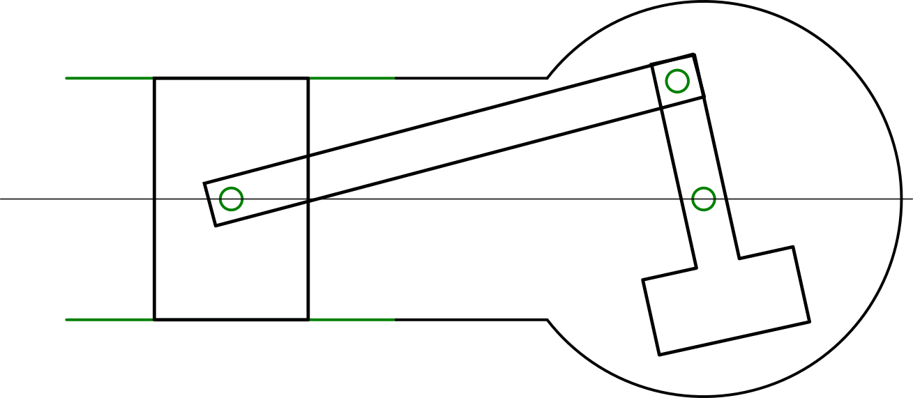
Systems of Constraints
Most models have many constraints.
The slider-crank model has 3 revolute joints and 1 translational constraint.
Each constraint is composed of 2 constraint equations.
The whole model has 8 constraint equations.
Translation Joint
Revolute
Joint 2
Body 1
Body 2
Revolute
Joint 3
Revolute
Joint 1
Cylinder/Crankcase
Body 3

Slide 70
Systems of Constraints
A system of constraint equations is expressed as a single vector of constraint equations:
Slider-crank example vector φ
Translation Joint
Revolute
Joint 2
Body 1
Body 2
Revolute
Joint 3
Revolute
Joint 1
Cylinder/Crankcase
Body 3

Slide 71
Derivatives of System Constraint Vector
A program that computes derivatives of the constraint vector φ must track which system coordinates each constraint φ_{i} is a function of.
If is a function of body coordinate vectors q ^{j} and q^{k}, then
if m is not j and not k
The row i of φ will generally have the form
Therefore, generally, φ_{,q} is a sparse matrix.

Slide 72
Additional Constraint Equations
The constraint equations add extra variables to the equations of motion:
In particular, the vector of constraint forces λ.
There are too many unknowns and not enough equations.
Number of system equations:
NumBodies * 3
One equation for every acceleration
Number of unknowns:
NumBodies * 3 + NumConstraintEqus.

Slide 73
Additional Constraint Equations
Additional equations are required to make the system solvable.
There are options for the additional equations.
Which option is correct depends on the goal.
Options:
Constraint equations (without change)
φ = 0
This option is often used with implicit differential equation solvers
This will be discussed tomorrow (Day 2).
2nd time derivatives of the constraint equations
dφ/dt² = 0
This option is used when computing the accelerations only.

Slide 74
Additional Constraint Equations for Acceleration
When computing the system accelerations, the additional equations are the 2nd time derivative of the constraint equations.
The system of equations becomes
The number of equations becomes are
NumBodies * 3 + NumConstraintEqus.
The system of equations is now solvable.

Slide 75
Gap Function as Function of Time
What is this equation?
φ = 0 is a set of algebraic restrictions on the values of q.
Conditions on q that must ALWAYS be true.
The time derivatives of the restrictions must also be true.
These time derivatives give us equations governing q̇ and q̈, too.

Slide 76
Gap Function as Function of Time
Usually, φ_{j} is only a function of position coordinates.
Be aware that φ_{j} can also be a function of time.
Example:
φ_{j} = θ^{i} − cos(ωt) = 0
These constraints change with time.
Usually used to create a driving constraint.
For example, to make a shaft spin at a given speed to drive other parts of a model.

Slide 77
Derivatives of Gap Function
It is easiest to express the formulation of d²φ_{i}/dt² for each component of φ independently.

Slide 78
Derivatives of Gap Function
If φ_{i} is only a function of position coordinates
(not a function of time)
Then:

Slide 79
Derivatives of Gap Function
If φ_{i} is a function of q and time, then use the chain rule of differentiation to find d²φ_{i}/dt²:

Slide 80
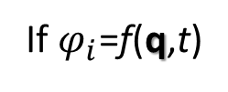
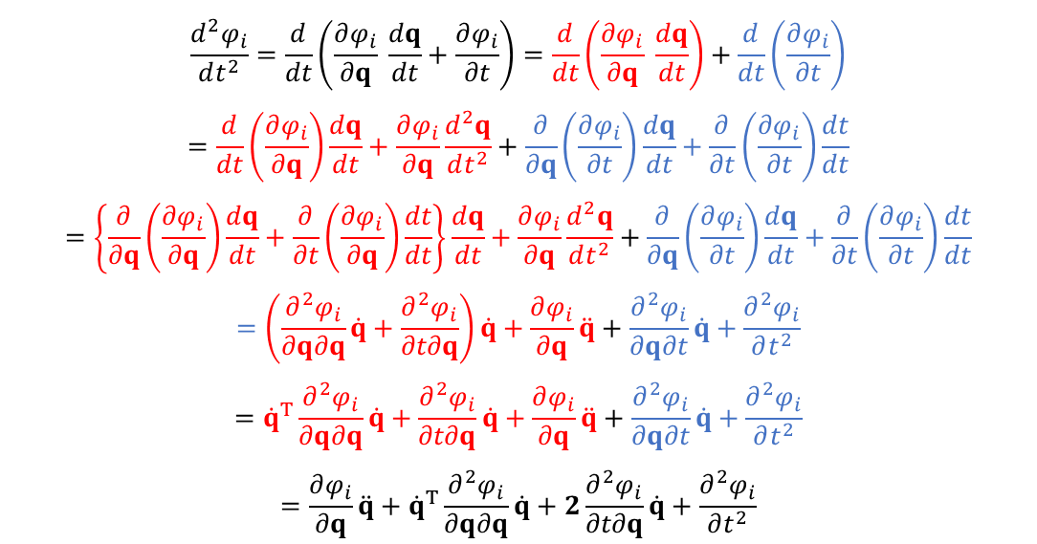

Derivatives of Gap Function
This page is not in the original version of this document. It has been added by a reader for reference.
If $φ_{i}$=f(q,t)
Then, the total derivative of $φ_{i}$ with respect to the parameter t is
$\frac{dφ_{i}}{dt}=\frac{∂φ_{i}}{∂q} \frac{dq}{dt}+\frac{∂φ_{i}}{∂t} \frac{dt}{dt}$= $\frac{∂φ_{i}}{∂q} \frac{dq}{dt}+\frac{∂φ_{i}}{∂t}$
$$\frac{d^{2}φ_{i}}{dt^{2}}=\frac{d}{dt}\left(\frac{∂φ_{i}}{∂q} \frac{dq}{dt}+\frac{∂φ_{i}}{∂t}\right)=\frac{d}{dt}\left(\frac{∂φ_{i}}{∂q} \frac{dq}{dt}\right)+\frac{d}{dt}\left(\frac{∂φ_{i}}{∂t}\right)$$
$$=\frac{d}{dt}\left(\frac{∂φ_{i}}{∂q}\right)\frac{dq}{dt}+\frac{∂φ_{i}}{∂q}\frac{d^{2}q}{dt^{2}}+\frac{∂}{∂q}\left(\frac{∂φ_{i}}{∂t}\right)\frac{dq}{dt}+\frac{∂}{∂t}\left(\frac{∂φ_{i}}{∂t}\right)\frac{dt}{dt}$$
$$=\left\{\frac{∂}{∂q}\left(\frac{∂φ_{i}}{∂q}\right)\frac{dq}{dt}+\frac{∂}{∂t}\left(\frac{∂φ_{i}}{∂q}\right)\frac{dt}{dt}\right\}\frac{dq}{dt}+\frac{∂φ_{i}}{∂q}\frac{d^{2}q}{dt^{2}}+\frac{∂}{∂q}\left(\frac{∂φ_{i}}{∂t}\right)\frac{dq}{dt}+\frac{∂}{∂t}\left(\frac{∂φ_{i}}{∂t}\right)\frac{dt}{dt}$$
$$=\left(\frac{∂^{2}φ_{i}}{∂q∂q}\dot{q}+\frac{∂^{2}φ_{i}}{∂t∂q}\right)\dot{q}+\frac{∂φ_{i}}{∂q}\ddot{q}+\frac{∂^{2}φ_{i}}{∂q∂t}\dot{q}+\frac{∂^{2}φ_{i}}{∂t^{2}}$$
$$={\dot{q}}^{T}\frac{∂^{2}φ_{i}}{∂q∂q}\dot{q}+\frac{∂^{2}φ_{i}}{∂t∂q}\dot{q}+\frac{∂φ_{i}}{∂q}\ddot{q}+\frac{∂^{2}φ_{i}}{∂q∂t}\dot{q}+\frac{∂^{2}φ_{i}}{∂t^{2}}$$
$$=\frac{∂φ_{i}}{∂q}\ddot{q}+{\dot{q}}^{T}\frac{∂^{2}φ_{i}}{∂q∂q}\dot{q}+2\frac{∂^{2}φ_{i}}{∂t∂q}\dot{q}+\frac{∂^{2}φ_{i}}{∂t^{2}}$$
If the function $φ_{i}$ is not an explicit function of the parameter t, then $\frac{∂φ_{i}}{∂t}$, $\frac{∂^{2}φ_{i}}{∂t∂q}$, $\frac{∂^{2}φ_{i}}{∂t^{2}}$ are equal to zero.

Slide 81
Derivatives of Gap Function
In both cases,
where
If φ_{i} is NOT a function of time:
If φ_{i} IS a function of time:

Slide 82
Derivatives of Gap Function
Solving for the q̈ term:
produces
In system vector form:
where

Slide 83
Final Form for Acceleration
Combine the 2nd time derivative of φ with the acceleration equations produces
In matrix-vector form, this becomes

Slide 84
Final Form for Acceleration
The form
is sometimes called “the augmented form” of the equations of motion for MBD.
This form is well-known in MBD.

Slide 85
Recursive Formulations
RecurDyn uses a modification of this formulation known as a constrained recursive formulation.
Recursive formulations reduce the number of unknowns in the equation of motion and many constraint forces.
A substitution is made in which body coordinates are replaced with rigid joint coordinates.
The recursive formulation used in RecurDyn is complex and requires a lot of time to explain in detail.
A simplified version that is much easier to understand is presented here.
The fundamental concept of the version presented here is very similar to the version used in RecurDyn.

Slide 86
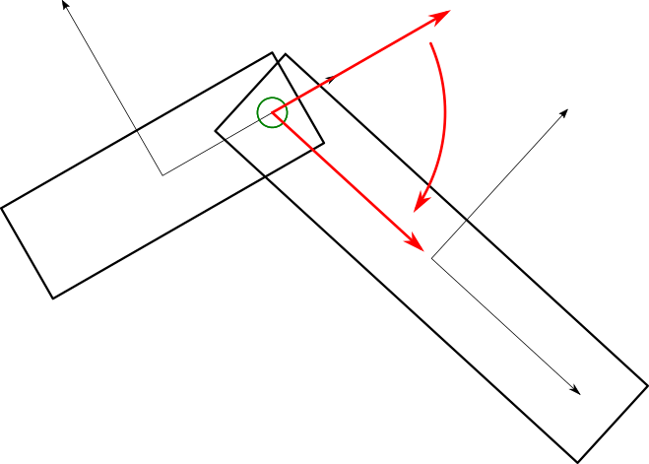
Recursive Formulations
Most rigid joint constraints have degrees of freedom.
A revolute joint has 1 joint degree of freedom ψ^{i}.
A joint degree of freedom is relative to the bodies.
Only fixed joints do not have joint degrees of freedom
Fixed joints make 2 rigid bodies act like 1 rigid body.
ψ^{i}

Slide 87
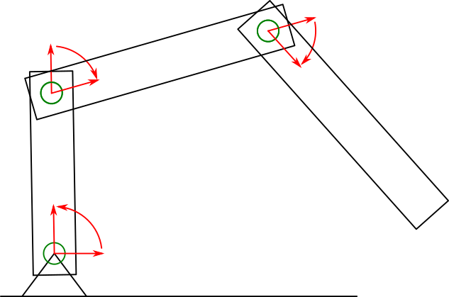
Recursive Formulation Degrees of Freedom
The joint degrees of freedom become coordinates of the system.
In this example, there are 3 joint DOFs.
ψ²
ψ³
ψ¹

Slide 88
Recursive Formulations Body to Joint Relations
The relationship between joint degrees of freedom and body coordinates is computed.
This changes with the motion of the bodies, so it must be recomputed every time acceleration is needed.
Body coordinates written as function of joint DOFs
Velocity relationship
(linear)
Acceleration relationship (also linear)

Slide 89
Recursive Formulations
The joint accelerations are substituted for the body accelerations in the equations of motion.
The B matrix is orthogonal to φ_{,q}.
So φ_{,q}B = 0. Therefore, premultiplying by B^{T} removes the joint constraint forces from the equations of motion.
Similar to Lagrangian equations of motion, constraint forces aren’t included when using only joint DOFs.

Slide 90
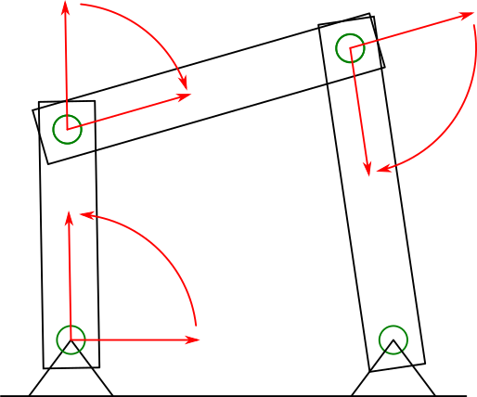
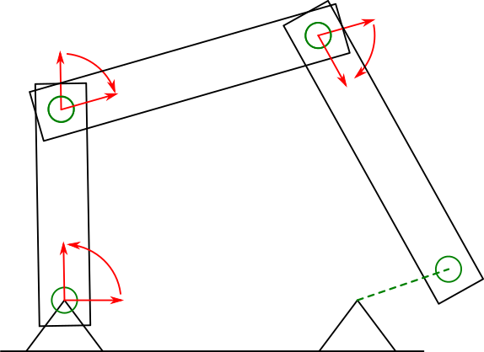
Recursive Formulations
Only open chains of bodies can be directly formulated.
Closed loops of bodies require a constraint.
Closed loops must be “cut open” by choosing a constraint to be a “cut joint”.
This joint remains a constraint in the recursive equations of motion.
Model with a closed loop
Loop opened by “cutting joint”
ψ²
Recursive system degrees of freedom
ψ³
ψ¹
A “cut joint” remains a constraint

Slide 91
Recursive Formulations
For systems with closed loops, some constraints remain in the recursive equations of motion.
Split φ into and into .
where
φ^{r} and λ^{r} are the recursive joints and constraint forces, which are orthogonal to B.
φ^{c} and λ^{c} are the cut joints and constraint forces, which will remain in the equations of motion.

Slide 92
Recursive Formulations
Then the directly formulated equations of motion become
Substitution of and pre-multiplication by B^{T} produces
which simplifies to

Slide 93
Recursive Formulation Final Equations of Motion
The final form of the constrained recursive formulation equations of motion require additional equations.
The acceleration formulation becomes:
or in matrix form:

Slide 94
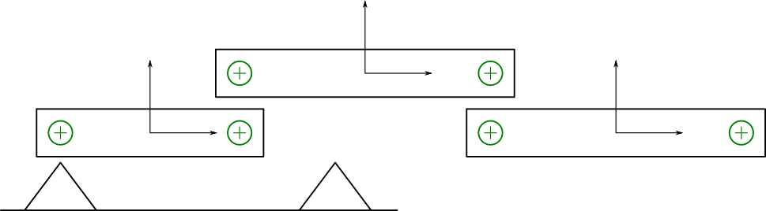
Simple Recursive Formulation Example
A simple example of a recursive formulation
Note that the example formulation here is designed to be easy to understand.
The recursive formulation used in RecurDyn is more complex.
RecurDyn’s recursive formulation involves many optimizations that enable it to be computed much faster.
ψ²
Body 2
sʹ_{c}²
Body 2
sʹ_{d}²
ψ³
sʹ_{a}¹
Body 1
Body 3
Body 1
sʹ_{b}¹
sʹ_{e}³
Body 3
sʹ_{f}³
ψ¹

Slide 95
Simple Recursive Formulation Example
A simple example of a recursive formulation
The body position to joint position relationship
ψ²
p_{d}²
ψ³
p_{b}¹
Body 2
Body 3
Body 1
ψ¹
p⁰
sʹ_{c}²
Body 2
sʹ_{d}²
sʹ_{a}¹
Body 1
sʹ_{b}¹
sʹ_{e}³
Body 3
sʹ_{f}³

Slide 96
Simple Recursive Formulation Example
The body velocity to joint velocity relationship

Slide 97
Simple Recursive Formulation Example
Converting the velocity relationship into a matrix-vector multiplication
Examining the equations of the velocity relationship, it is possible to rewrite them as a series of matrix-vector multiplications.

Slide 98
Simple Recursive Formulation Example
Continuing the matrix re-arrangement of the velocity equations:

Slide 99
Recursive Example Velocity Relationship Form
Finally, the velocity relationship can be written as a matrix-vector product
High performance recursive formulations have much more computationally inexpensive forms of the B matrix.
But many modifications are required for this.
For example, all body velocities are expressed in their body reference frames.
Each reduction equation
Combining reduction equations
Final body velocity - joint velocity relationship

Slide 100
Constraint Complexities
There are some well-known issues with constrained MBD.
Over-constraint
Singular configurations
Solution difficulties
Much more about this tomorrow

Slide 101
Constraint Complexities
Constrained MBD issues:
Over-constraint
It is possible to have too many constraints.
Constraints are a mathematical simplification.
Too many constraints causes the final form of the equations of motion to be singular, so they cannot be solved.
Singular configurations
Even if the number of constraints is acceptable, it is possible for a particular position of the bodies to cause the system matrix to become singular.
Solution difficulties
The constrained MBD differential equations are not easy to solve.

